Slide 1
THE INTERNAL CONTROL STRUCTURE
INTRODUCTION TO INTERNAL CONTROL
Internal control has become more important to management, independent auditors and also the external parties like the regulatory authorities.
Topic’s highlights will include among other things:
the importance of internal control
methodology + considerations in assessing control internal controls
requirements for documenting internal control systems
auditor communication concerning internal control structure of client.

Slide 2
THE INTERNAL CONTROL STRUCTURE
INTRODUCTION TO INTERNAL CONTROL
“Internal control is a process effected by the entity’s board of directors, management and other personnel, designed to provide reasonable assurance regarding the achievement of objectives in:
Reliability of financial reporting
Compliance with applicable laws and regulations
Effectiveness and efficiency of operations

Slide 3
THE INTERNAL CONTROL STRUCTURE
INTRODUCTION TO INTERNAL CONTROL
Internal control system or structure is the plan of organization and all the methods and procedures adopted by management to assist in achieving management’s objectives.
It is the responsibility of management to maintain adequate internal control structure as effective internal control structure provides assurance to management that:
The conduct of business is orderly and efficient.
Irregularities are prevented, and detected should they occur.

Slide 4
THE INTERNAL CONTROL STRUCTURE
INTRODUCTION TO INTERNAL CONTROL
…….continue
Assets are safeguarded from unauthorized use or disposition.
Financial records and other relevant databases completely and accurately reflect the entire operational activities of entity and also permit for timely preparation of financial information.

Slide 5
THE INTERNAL CONTROL STRUCTURE
INTRODUCTION TO INTERNAL CONTROL
An organization with good internal control may have 2 types of well functioning controls:
Administration control
Designed to achieve efficiency in operation through for example, organizational structure, policies towards human resources, management philosophy etc.
b) Accounting control
Sometimes overlap with administration control. Three control arrangements are internal auditing, internal control procedures and other accounting related controls.

Slide 6
THE INTERNAL CONTROL STRUCTURE
INTRODUCTION TO INTERNAL CONTROL
Importance of internal control to auditor:
Examination and evaluation of clients internal control systems form part of auditor’s work. The evaluation will influence the extent of audit procedures needed to be conducted by auditor to form opinion on the fairness of the financial statements.
A good internal control systems will help in exposing weaknesses, errors and also fraud eventually. If internal control systems of client are reliable, auditor will be able to reduce the substantive tests or procedures.

Slide 7
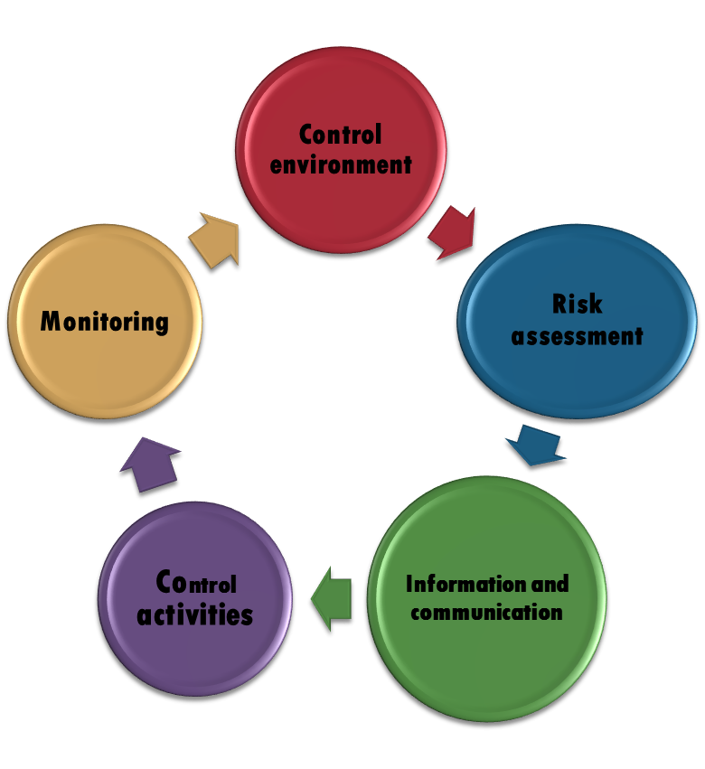
THE INTERNAL CONTROL STRUCTURE
INTRODUCTION TO INTERNAL CONTROL
In undertaking an audit of financial information, the auditor’s task in considering the internal control structure is to identify matters that are relevant to the audit, particularly relating to the reliability of financial reporting.
Five (5) inter-related components of internal control.

Slide 8
THE INTERNAL CONTROL STRUCTURE
Inherent limitations exist in any internal control structure:
Mistakes in judgment by management or others because of inadequate information or time constraints.
Breakdowns in established controls because of failure to understand instructions, carelessness, fatigue, distractions.
Collusion among employees to penetrate or conceal irregularities.
Management override of controls for illegitimate purposes.
Cost versus benefits trade off.

Slide 9
THE INTERNAL CONTROL STRUCTURE
The following parties have responsibilities for internal controls:
Management should set up “tone at the top” for control consciousness.
BOD and audit committees should determine that management meet its responsibilities for establishing and maintaining controls.
Internal auditors should periodically examine and evaluate control structure and recommend improvements.

Slide 10
THE INTERNAL CONTROL STRUCTURE
The following parties have responsibilities for internal controls:
Other personnel should communicate any non-compliance with controls.
Independent auditors should understand controls sufficient to plan the audit and report deficiencies to the audit committees.
External parties establish minimum requirements for establishment of internal controls.

Slide 11
THE INTERNAL CONTROL STRUCTURE
Factors affecting the control environment are:
Integrity and ethical values
Commitment to competence at every organizational level
BOD and audit committee
Management’s philosophy and operating style
Organizational structure
Assignment of authorities and responsibility
Human resource policies and practices

Slide 12
THE INTERNAL CONTROL STRUCTURE
Management’s risk assessment for financial reporting purposes is similar to the independent auditor’s concern with inherent risk.

Slide 13
THE INTERNAL CONTROL STRUCTURE
In order to establish control:
Establishing a relevant information system, of which an accounting system is a subset, to maintain accountability and clear communication of individual roles and responsibilities under the system is critical.
Accounting systems focus on identifying and measuring transactions in sufficient detail is important to permit proper financial presentation.

Slide 14
THE INTERNAL CONTROL STRUCTURE
Controls consist of:
Information processing controls that include data centre organization, hardware and systems software, and back-up and recovery procedures. Also important is the application controls such as authorization, documents and records, and independent checks.
Proper authorization procedures.
Physical controls to limit direct and indirect access to records and assets.

Slide 15
THE INTERNAL CONTROL STRUCTURE
…. Controls consist of:
Performance review, including summarization of detail balances, actual versus budget comparisons, financial and non-financial data comparisons.
Monitoring activities to focus management’s attention on problem areas.

Slide 16
THE INTERNAL CONTROL STRUCTURE
Proper authorization procedures ensures that transactions are authorized by management personnel acting within the scope of their authority. Authorization procedures are important in limiting access to assets, documents and records and computer information systems.
Examples proper authorization needed in matters regarding:
Procurement of fixed assets.
Investment of company’s funds.
Signage of cheques.
Write-off of bad debts.

Slide 17
THE INTERNAL CONTROL STRUCTURE
Documents provide evidence of the occurrence of transactions while records provide summaries of issued documents.
Pre-numbering of documents and appropriate follow-up and filing provides assurance that all transactions are recorded and recorded only once (completeness assertions).
Independent comparison of records with document details provides additional assurance that all recorded transactions are documented (existence/ occurrence assertions) and that the transactions are properly priced (valuation and measurement assertion).

Slide 18
THE INTERNAL CONTROL STRUCTURE
Independent checks involve the verification of:
Work previously performed by other individuals or departments.
The proper valuation of recorded amounts.

Slide 19
THE INTERNAL CONTROL STRUCTURE
Segregation of duties involves the assignment of responsibilities so that the duties of one employee automatically provide a cross check on the work of one or more other employees. It can be achieved through:
Responsibility for executing a transaction, recording the transaction, maintaining custody of assets resulting from transaction, should be assigned to different individuals.
Various steps involved in executing a transaction should be assigned to different individuals or departments.

Slide 20
THE INTERNAL CONTROL STRUCTURE
Segregation of duties involves the assignment of responsibilities so that the duties of one employee automatically provide a cross check on the work of one or more other employees. It can be achieved through:
Responsibility for certain accounting operations should be segregated.
There should be proper segregation of duties within CIS department and between CIS and user departments.

Slide 21
THE INTERNAL CONTROL STRUCTURE
Physical controls are concerned with limiting direct access (eg: to cash and inventories) or indirectly (eg: preparing and processing of documents to unauthorized individual).
When computer information processing is used, access to computer, computer records, data files and programmes should be restricted to authorized personnel.

Slide 22
THE INTERNAL CONTROL STRUCTURE
Monitoring refers to the periodic assessment of the quality of internal control structure.
All the five components of the internal control structure are applicable to entities of all sizes. However the degree of formality and implementation of these components may be influenced by factors such as size and ownership. Small entities are less likely to have written policies and owner-managers involvement in certain critical tasks can aid controls.

Slide 23
THE INTERNAL CONTROL STRUCTURE
OBTAINING AN UNDERSTANDING OF INTERNAL CONTROL STRUCTURE.
An understanding of the internal control structure is used to identify types of potential misstatements, consider risk and design substantive procedures.

Slide 24
THE INTERNAL CONTROL STRUCTURE
Procedures to obtain understanding include:
Reviewing prior experience with entity.
Making inquiries of appropriate management, supervisory and other entity’s personnel.
Inspecting records, review systems and systems documentation.
Observing entity’s activities and operations.

Slide 25
THE INTERNAL CONTROL STRUCTURE
DOCUMENTING THE UNDERSTANDING
Independent auditor can document their understanding of internal control structure through completed questionnaires, flow charts, narrative memoranda.
A transaction walk-through review consists of tracing one or a few transactions within a major class of transactions through transaction trail and identify related control procedures.

Slide 26
THE INTERNAL CONTROL STRUCTURE
DOCUMENTING THE UNDERSTANDING
A questionnaire consists of a series of questions about whether controls necessary to prevent and detect irregularities and material misstatements in the financial statements are included in the control structure.
A flow chart is a schematic diagram using standardized symbols, interconnecting flow lines and annotations that portray the steps involved in processing transactions through the information system.

Slide 27
THE INTERNAL CONTROL STRUCTURE
DOCUMENTING THE UNDERSTANDING
A narrative memoranda consists of written comments concerning the auditor’s considerations of internal control structure.

Slide 28
THE INTERNAL CONTROL STRUCTURE
Internal Control Evaluation Process
Planning level
Planning involves:
Auditor trying to answer question as to whether internal control systems exist and operative in client’s organization. To answer, overview and establish an understanding on client’s administrative and accounting/ financial controls.

Slide 29
THE INTERNAL CONTROL STRUCTURE
Internal Control Evaluation Process
2) Reviewing and Evaluation level
Reviewing process involves:
Auditor will be more thorough in his work by testing a few transactions in order to secure better understanding. To do so, auditor will be reviewing previous working file, observing and inquiring officials and looking through documents such as organizational charts, manuals, department’s working papers, circulars etc. He will then records his findings in the audit working papers (by means of narratives, filling of questionnaires (ICQ) or flowcharts).

Slide 30
THE INTERNAL CONTROL STRUCTURE
Internal Control Evaluation Process
2) …...Reviewing and Evaluation level
Evaluation process involves:
Evaluating types of errors or weaknesses.
Identifying the right procedure to avoid errors or weaknesses.
Ensure that the right procedure exists or not.
Decide whether to rely on the control or not.

Slide 31
THE INTERNAL CONTROL STRUCTURE
…...Reviewing and Evaluation level
Results:
a) No system/procedure in place, or procedure/system not adhere to.
In this case, it is best not to rely on the system/ procedure.
Therefore: type of tests, timing and level of substantive tests will change (need to increase).
Results:
b) System/procedure in place, or procedure/system are adhered to.
Therefore: Ensure that procedure/ systems continue to exist and operate.

Slide 32
THE INTERNAL CONTROL STRUCTURE
Internal Control Evaluation Process
3) Confirmation level (Substantive Procedure)
Tests conducted to obtain evidence regarding completeness, accuracy and validity of accounting records and financial statements.
Internal Control
(% of reliability)
Substantive Tests (quantities)

